Slide 1

Twitch ENGB Network Analysis
Comparative Network Analysis Using Network Science
Răzvan-aNDREI Moga

Slide 2
Introduction to the Twitch ENGB Network
We aimed to explore the community structure and key influences in the English-British Twitch friendship network using SNAP's real Dataset.
Dataset: Twitch English/British user–user friendships
Source: Stanford Network Analysis Project (SNAP) https://snap.stanford.edu/data/twitch-social-networks.html
Nodes (N): 7 126 Twitch streamers
Edges (L): 35 324 mutual friendships
Features: streaming habits, language use, game interests (e.g. mature-content flag, primary games played)

Slide 3
Goals and research
Understand structural properties of the Twitch ENGB network – e.g. degree distribution, clustering, shortest paths, connected components
Compare with benchmark null-models – Random (Erdős–Rényi) vs. Scale-Free (Barabási–Albert)
Identify important streamers and potential influencers – via degree, betweenness, eigenvector centralities
Explore the role of mature vs. non-mature users – differences in connectivity, clustering, and homophily
Main Questions:
How is the Twitch community structured?
Do streamers group by behavior (e.g., maturity flag)?
Are there influential or central users?

Slide 4
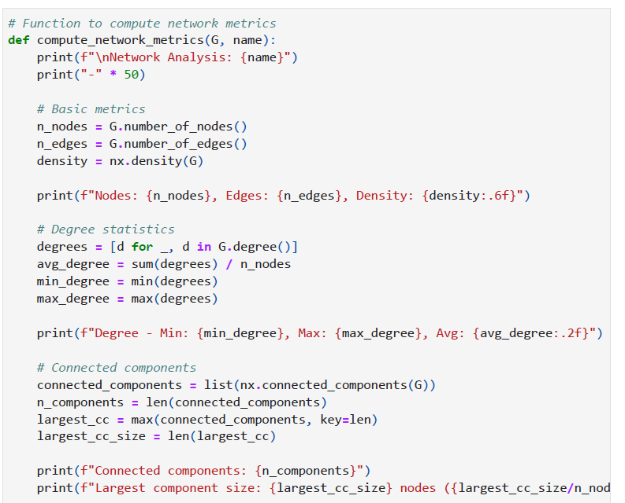
General Network Structure
Number of nodes (N): 7 126
Number of edges (L): 35 324
Density: 0.00139 (very sparse)
Connectivity: 100 % of nodes in a single connected component
Diameter: 10
Average path length (⟨ℓ⟩): 3.68

Slide 5
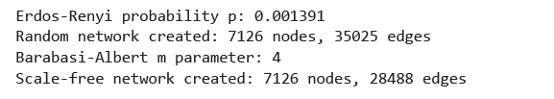
Artificial Networks
1. Random network (Erdős–Rényi model):
Start with N nodes and, for each pair, add an edge with independent probability p.
(Clustering is extremely low and there are no pronounced hubs)
2. Scale-free network (Barabási–Albert model):
Grow the network one node at a time, attaching each newcomer to m existing nodes chosen with probability ∝ their current degree.
(Captures the “rich-get-richer” dynamics seen in real social and information networks.)

Slide 6
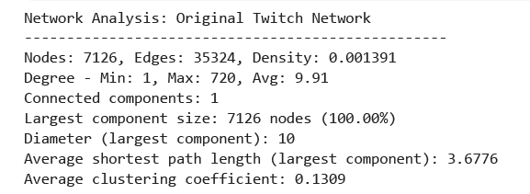
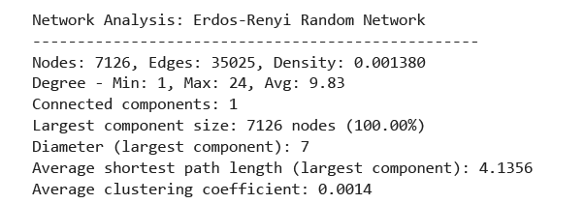
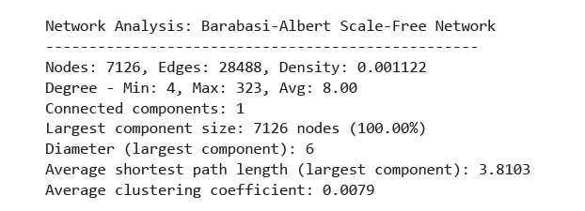
Networks Comparison
combines both pronounced hubs and high local cohesion—features neither null model captures fully
matches the overall sparsity & path‐length of the real Twitch network but has no hubs and virtually zero clustering

Slide 7
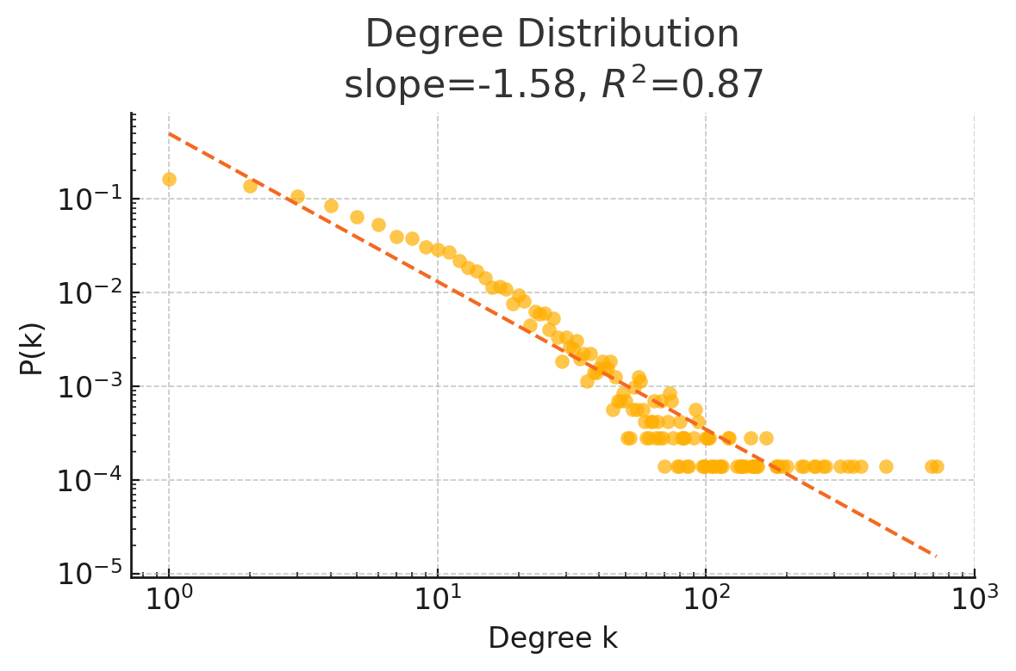
Degree distribution
Goal: Show the heavy-tailed nature of node connectivity in the Twitch ENGB network
Power-law tail: the majority of streamers have few connections, while a small number of hubs have very high degree
Scale-free indicator: straight line on log–log axes confirms non-random structure
Fit results:
Slope (α): –1.58
Goodness of fit (R²): 0.87

Slide 8
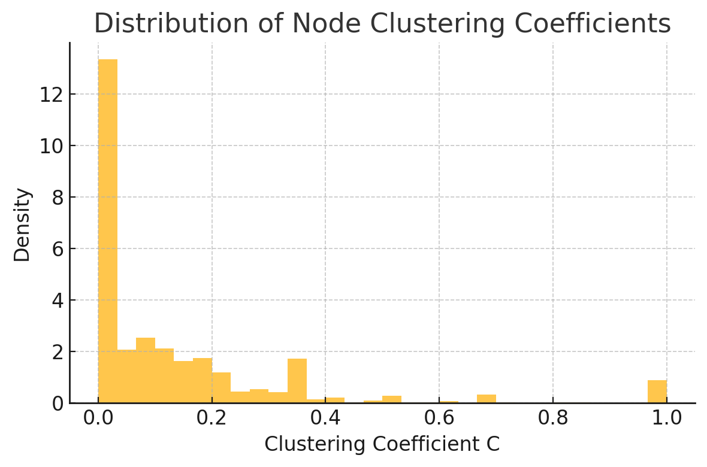
Distance and clustering metrics
Diameter: 10
Avg. shortest path: 3.68 → small-world traits
Avg. clustering coefficient: 0.1309
Implies local group cohesion and potential community structure
Many nodes have low local clustering but a meaningful tail of higher- clustering vertices, indicating pockets of tight-knit communities.

Slide 9
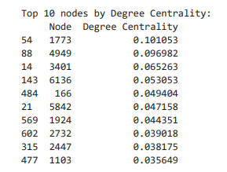
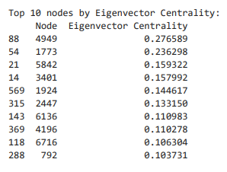
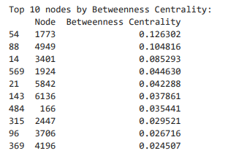
Centrality and Influential Nodes
Measures used:
Degree centrality
Betweenness
Eigenvector centrality
TOP NODES:
1773, 4949, 3401
consistent across all metrics
These nodes act as influencers/hubs

Slide 10
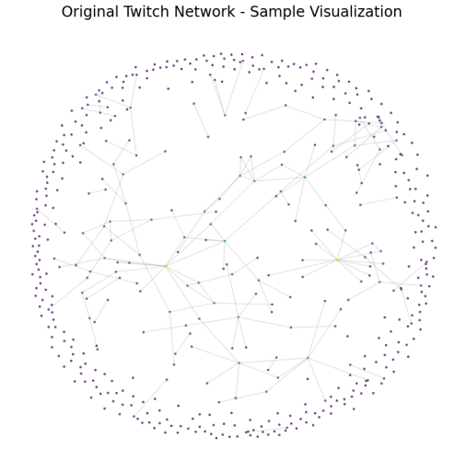
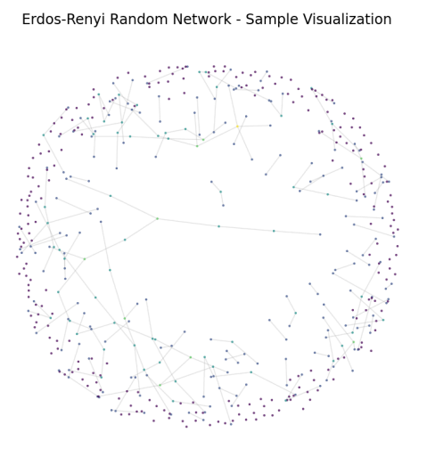
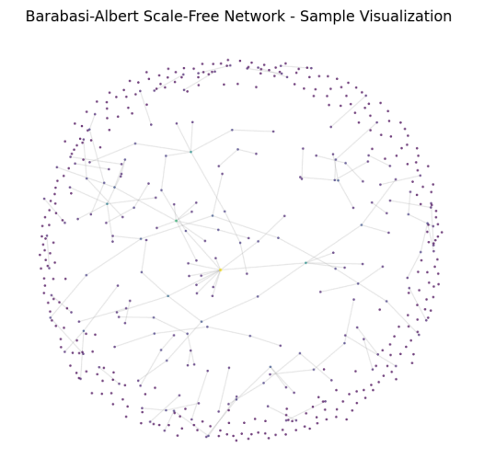
Benchmark Model Comparison
Metric | Twitch | Random | Scale-Free
Avg Degree | 9.91 | 9.83 | 8.00
Clustering Coeff. | 0.131 | 0.0014 | 0.0079
Shortest Path Length | 3.68 | 4.13 | 3.81
Twitch network is not random!
Best fits the scale-free model, with small-world traits

Slide 11
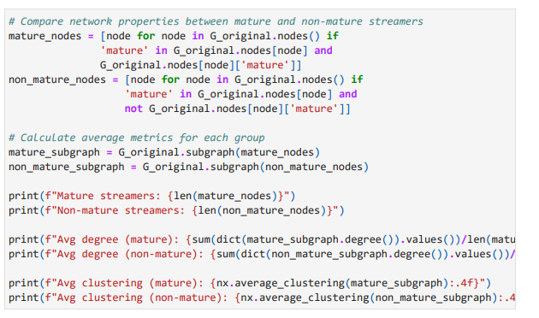
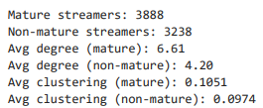
Behavior-Based Subgroups
Comparison: Mature vs Non-Mature streamers
Mature:
Avg. degree: 6.61
Clustering: 0.105
Non-Mature:
Avg. degree: 4.20
Clustering: 0.097
Mature streamers are more connected and clustered

Slide 12
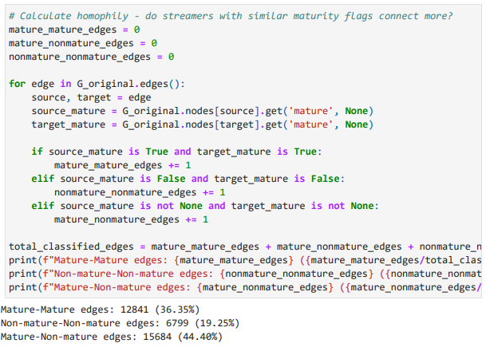
Homophily in the Network
Mature–Mature edges: 36.3%
Non-Mature–Non-Mature: 19.3%
Mixed edges: 44.4%
Weak to moderate homophily: similar streamers tend to connect

Slide 13
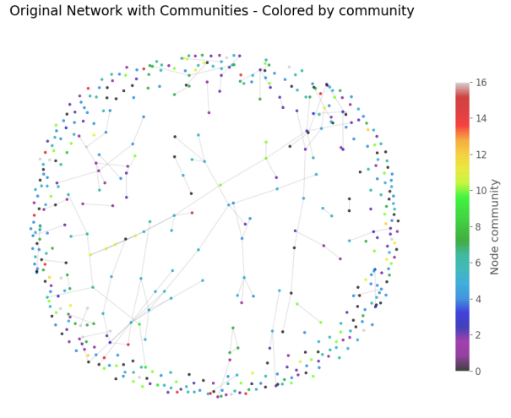
Community Detection – Louvain Method
Used the Louvain algorithm to detect structural communities in the Twitch network.
Nodes grouped to maximize modularity, revealing clusters of densely connected streamers.
Found clear community structure, but weak correlation with maturity or partner status.
Insight: network structure captures patterns not visible in streamer attributes.

Slide 14
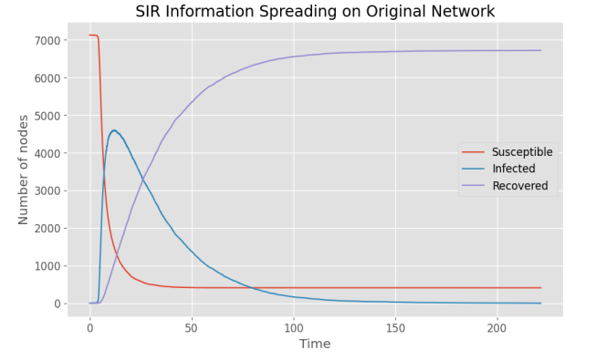
SIR Model – Information Spread Simulation
Ran a SIR simulation (Susceptible-Infected-Recovered) on the largest network component.
Parameters:
𝑅0​ =2.5, 𝛽=0.1, γ=0.04
Started from one infected node → simulated spread over time.
Curve shows typical viral behavior: sharp infection peak, followed by recovery.
Insight: Twitch network allows fast, large-scale diffusion due to its structure.

Slide 15
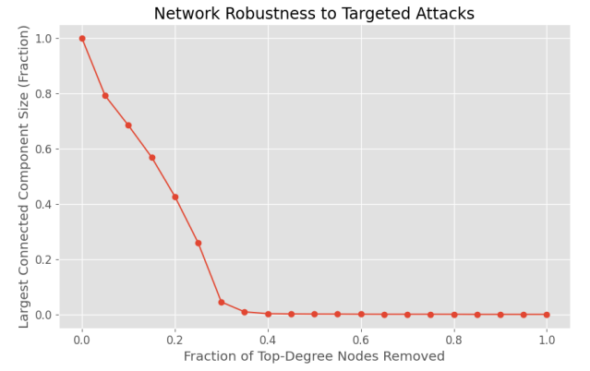
Robustness to Targeted Attacks
Simulated removal of top-degree nodes to test structural stability.
Even small-scale removal led to rapid network fragmentation.
Largest connected component shrinks quickly → Twitch is not robust to targeted attacks.
Insight: hubs are critical for keeping the network connected.

Slide 16
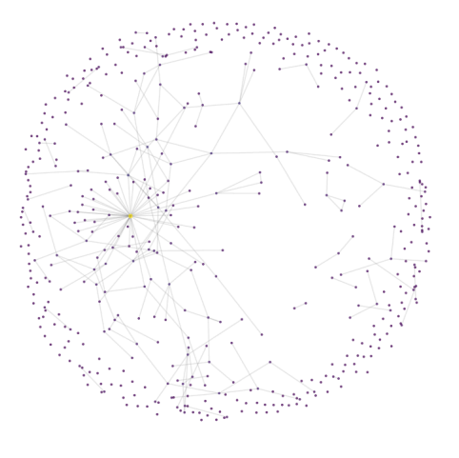
Key Insights - Network Structure
Diameter: 10 → short paths between users.
Avg. path length: ~3.68 → fast information flow.
Clustering: 0.131 → strong local communities.
Degree distribution: Power-law → few hubs, many low-degree nodes.
Structure: Fully connected → high cohesion.

Slide 17
Key Insights - Central Streamers & Community Behavior
Node 1773: top in degree & betweenness → key connector.
Node 4949: top in eigenvector → linked to other hubs.
Homophily:
36% mature–mature
19% non–non
44% mixed
Mature users: more connected, more clustered.

Slide 18
Key Insights - Robustness & Model Comparison
Node removal → network breaks quickly → scale-free vulnerability.
SIR model: fast spread → high virality.
Compared to models:
Clustering much higher than random or scale-free.
Matches scale-free in degree and robustness.
Conclusion: Twitch = scale-free + small-world traits.

Slide 19

CONCLUSIONS
Twitch shows scale-free structure with key hubs and a power-law degree distribution.
Strong local clustering and short paths → small-world traits.
Mature streamers form tighter communities with mild homophily.
Network supports fast diffusion but is vulnerable to targeted attacks.
Overall: Twitch combines hub-driven influence with local group cohesion.

Slide 20
THANK YOU

